Slide 1
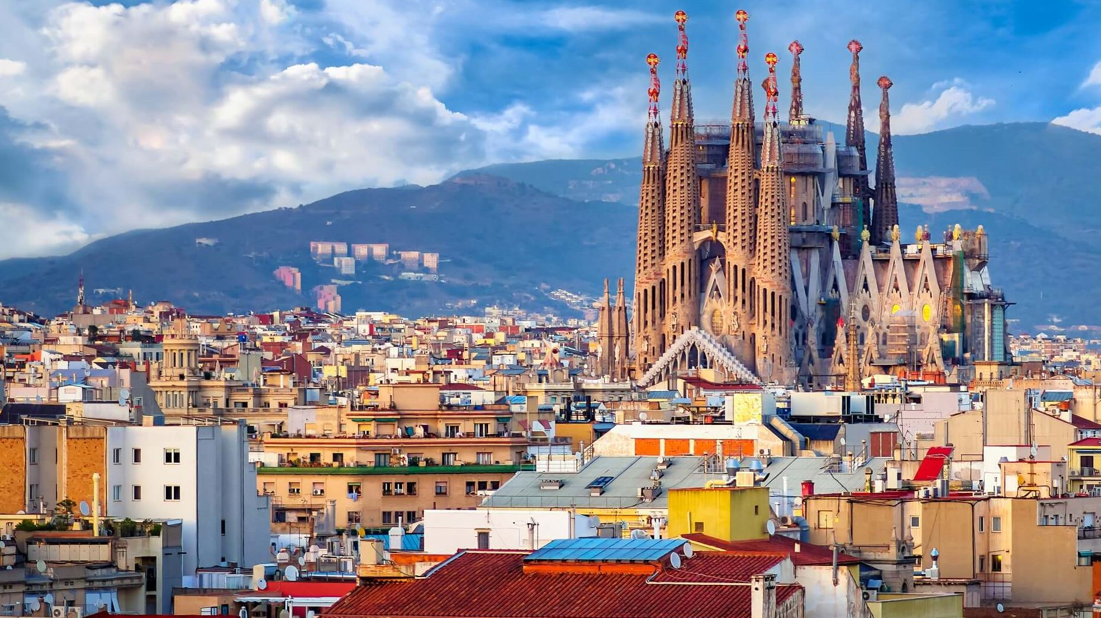
BARCELONA
MODERNISTA
3 NIGHTS INCENTIVE PROGRAM

Slide 2
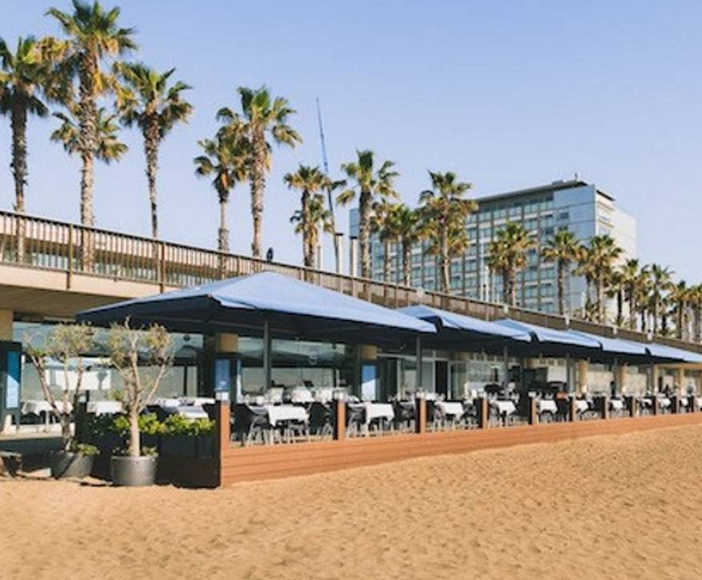
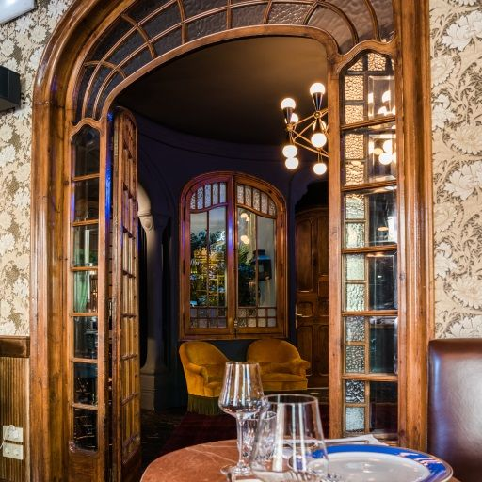

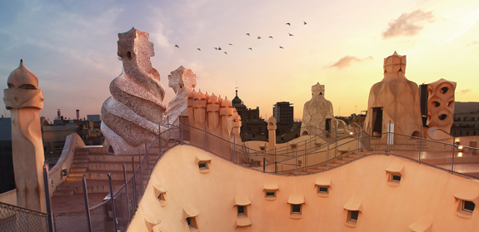
DAY 1: Welcome to Barcelona!
Arrival at Bcn airport & transfer to your hotel. Welcome drink, keys delivery
Transfer to the seaside for a nice paella lunch by the sea, followed by a panoramic tour of the city and its different architectural areas.
Early evening, we will enjoy a private tour of one of the Modernist gem of the city, Casa Mila, ending with a glass of sparkling cava in its magnificent rooftop.
The day will end with a classic and sophisticated dinner held in a Modernist venue.

Slide 3
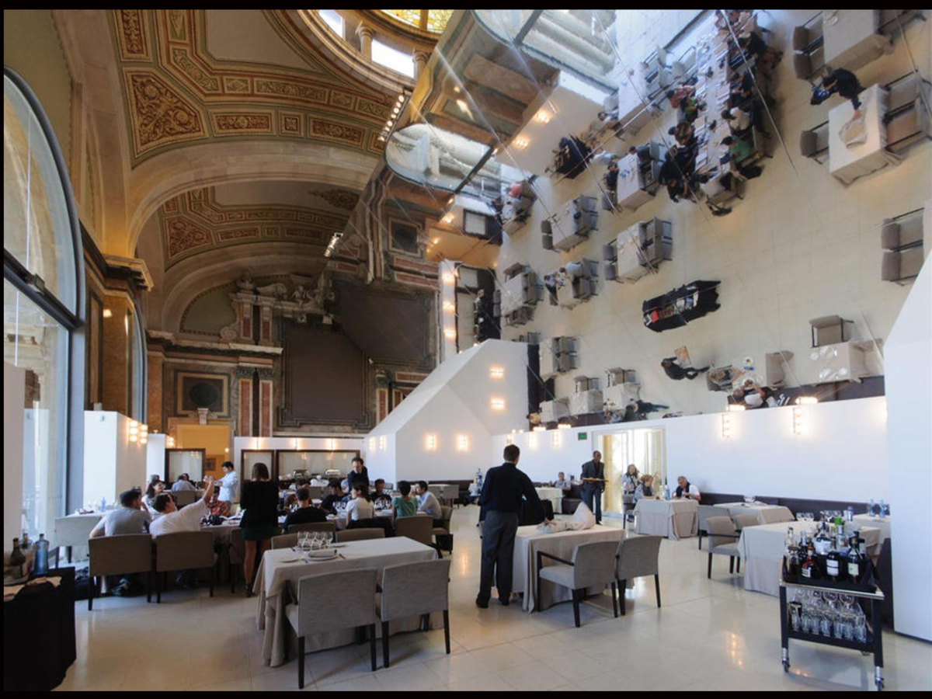
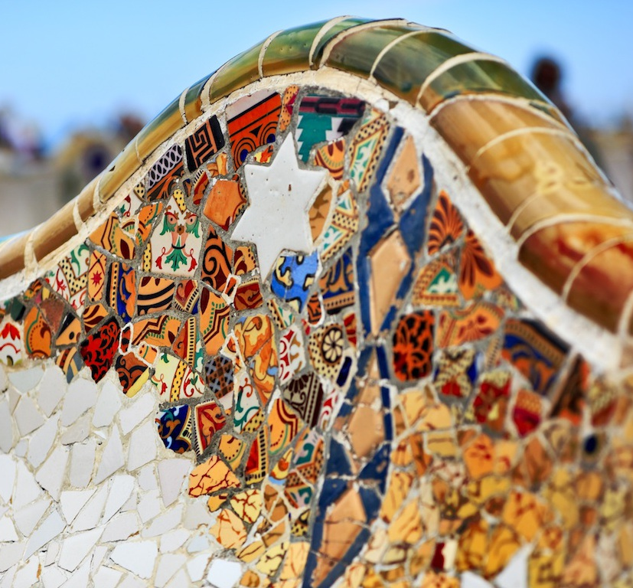
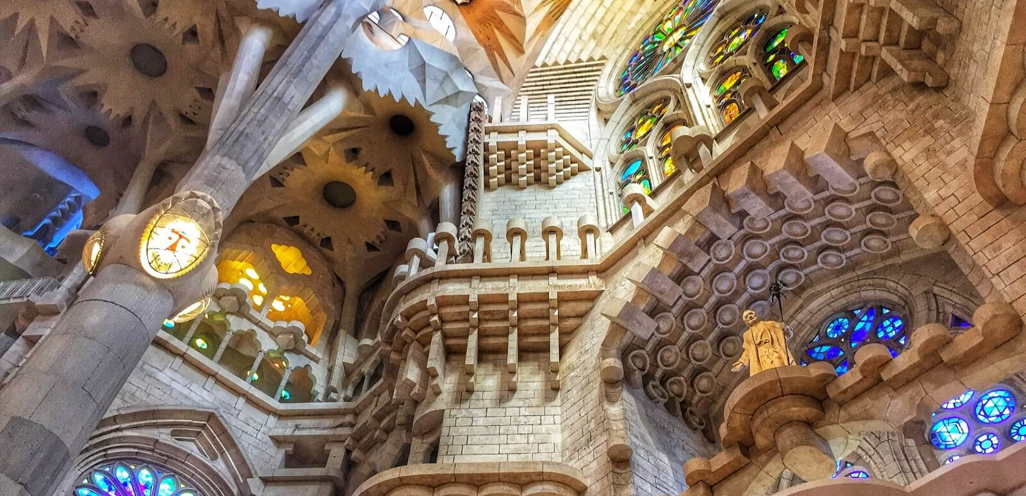
DAY 2: Culture Immersion
Our day will start after breakfast, with the must see for any architecture lover: a visit of Sagrada familia and Park Guell, led by our specialized guides, who will make you travel inside Gaudi's magic world and mind.
Lunch will take place in another, less known Modernist venue in the city also designed by the genius architect, allowing you to connect in a most intimate way. This is where we will set up our creative team building: the trencadis workshop, during which participants will create their own workcraft using Gaudi's famous mosaic work technique.
In the evening, we will head to MNAC museum, guardian of Modernist culture, for a lovely dinner with direct views on Montjuic Magic fountains

Slide 4
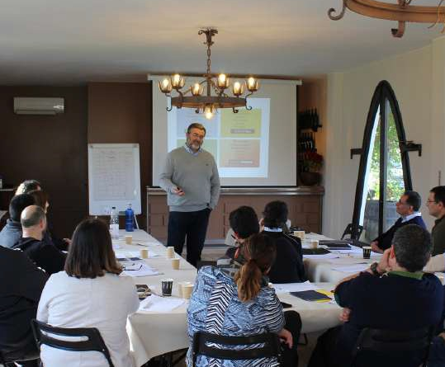
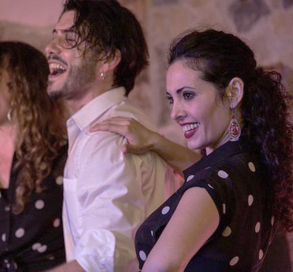
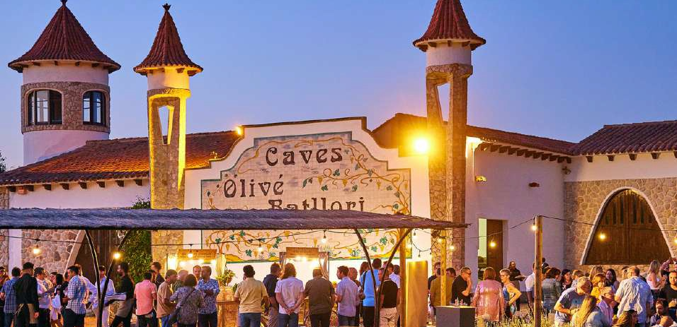
DAY 3: Gatronomy & tradition
Today, we will escape from the city to discover Catalonia land and its most rooted traditions. After breakfast, we will head to Penedes region, the land of wine and world famous cava.
Our day trip destination will be a Modernist family owned cava cellar . The familly will guide us through their land, their history and the secrets of their production After the visit and a tasting masterclass, we will enjoy a ressourcing outdoor lunch and discover one of the most awe-inspiring cultural expressions in Catalonia. It is the art of building human towers, known as castells, where teams (colles) work together to form towering structures—sometimes reaching up to ten levels high. More than just a physical feat, Castells embody the Catalan spirit of unity, resilience, and trust. Each tower is a breathtaking display of strength, balance, courage, and teamwork (força, equilibri, valor i seny).
Back in the city, Gala dinner will be held in a private venue where modernist atmosphere will meet one of the most lively and festive sides of Catalan traditions: the rumba catalana. Dancers and musicians will warm up the atmosphere through dinner and create the perfect atmosphere for everyone to unwind and have fun for the "fin de fiesta" after dinner.

Slide 5
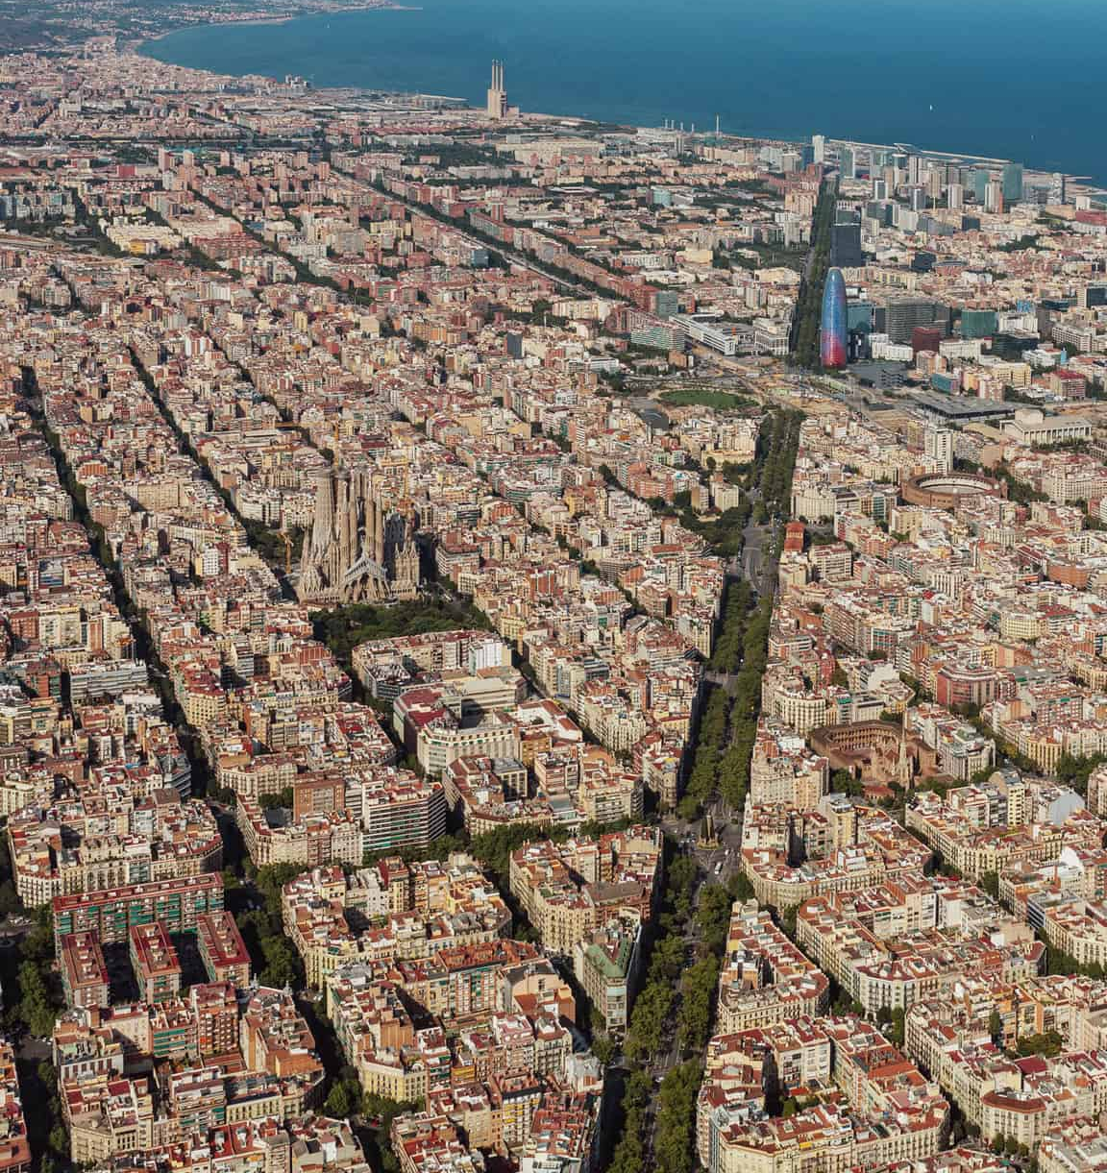
DAY 4: Hasta Pronto!
Breakfast, check out & transfer to the airport
Tell us about your project and we will discuss the best options for your event, according to your budget and special needs.

Slide 6
